Slide 1
Client Drink Project: Beer
By
Team Variance

Slide 2
Agenda: Project Beer
Scope
Summary of Results
Key Take-Aways / Next Steps
Team Variance Members:
Terry Johnson
Steven Cocke
Brandon de la Houssaye

Slide 3
Scope: Project Beer
Query: Client Drink retained Team Variance to analyze the relationship of alcohol content and bitterness taste measures in beer.*
Results: Yes. There is an appearance of a relationship (higher alcohol aligns with greater bitterness)
Limitations:
Analysis limited to visual evidence (i.e., not statistically conclusive)
Data & info considered was not audited by Team Variance
Project Beer does not address the ‘why’. Future engagements will cover.
*Additional queries addressed include: # of breweries available in each state; number of unavailable data points (by variable); which state has the maximum ABV and IBU; and summary statistics of ABV variable.

Slide 4
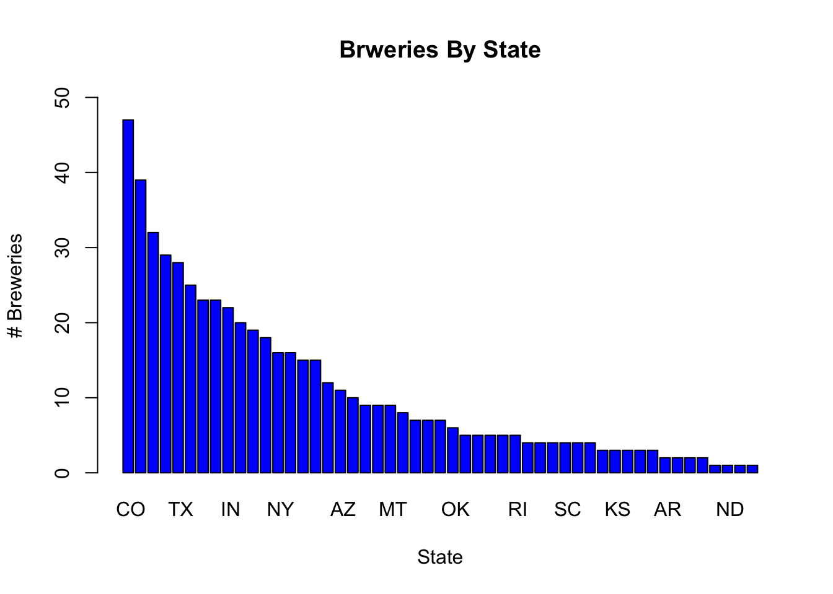
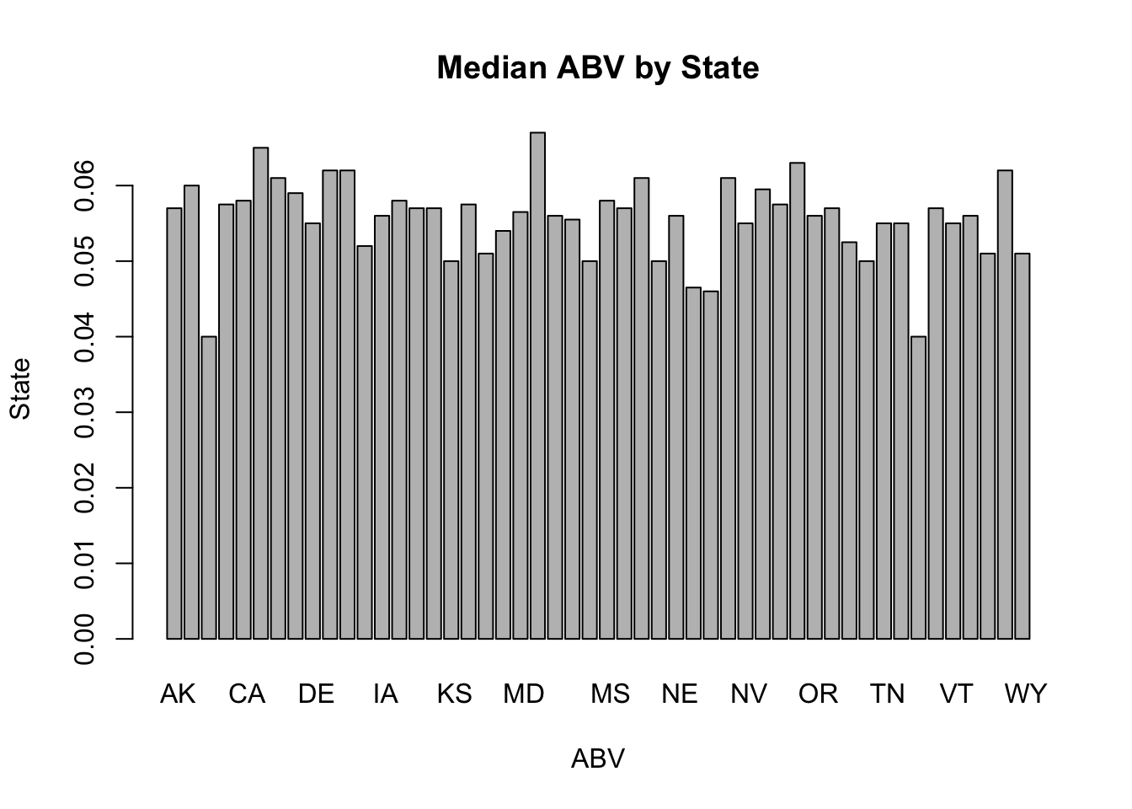
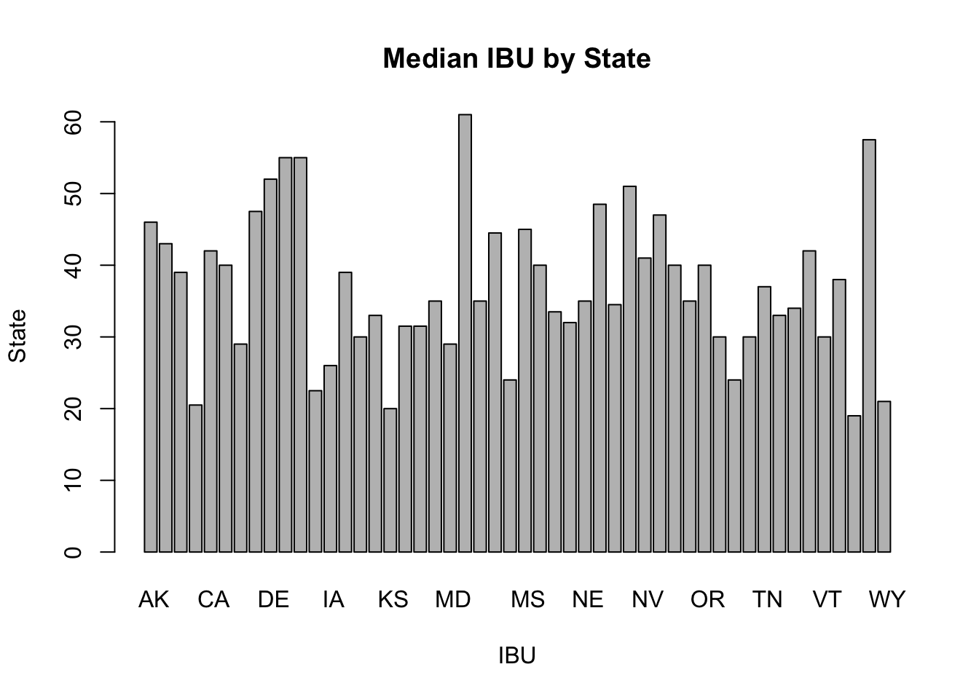
Summary of Results: Project Beer
Breweries by State: there are differences in the number of breweries by state
Median ABV: the medians are different by state
Median IBU: the medians are different by state

Slide 5
Summary of Results: Highest ABV, IBU, and Summary Stats for ABV
State with highest ABV: Colorado
State with highest IBU: Oregon
Summary Statistics for ABV:

Slide 6
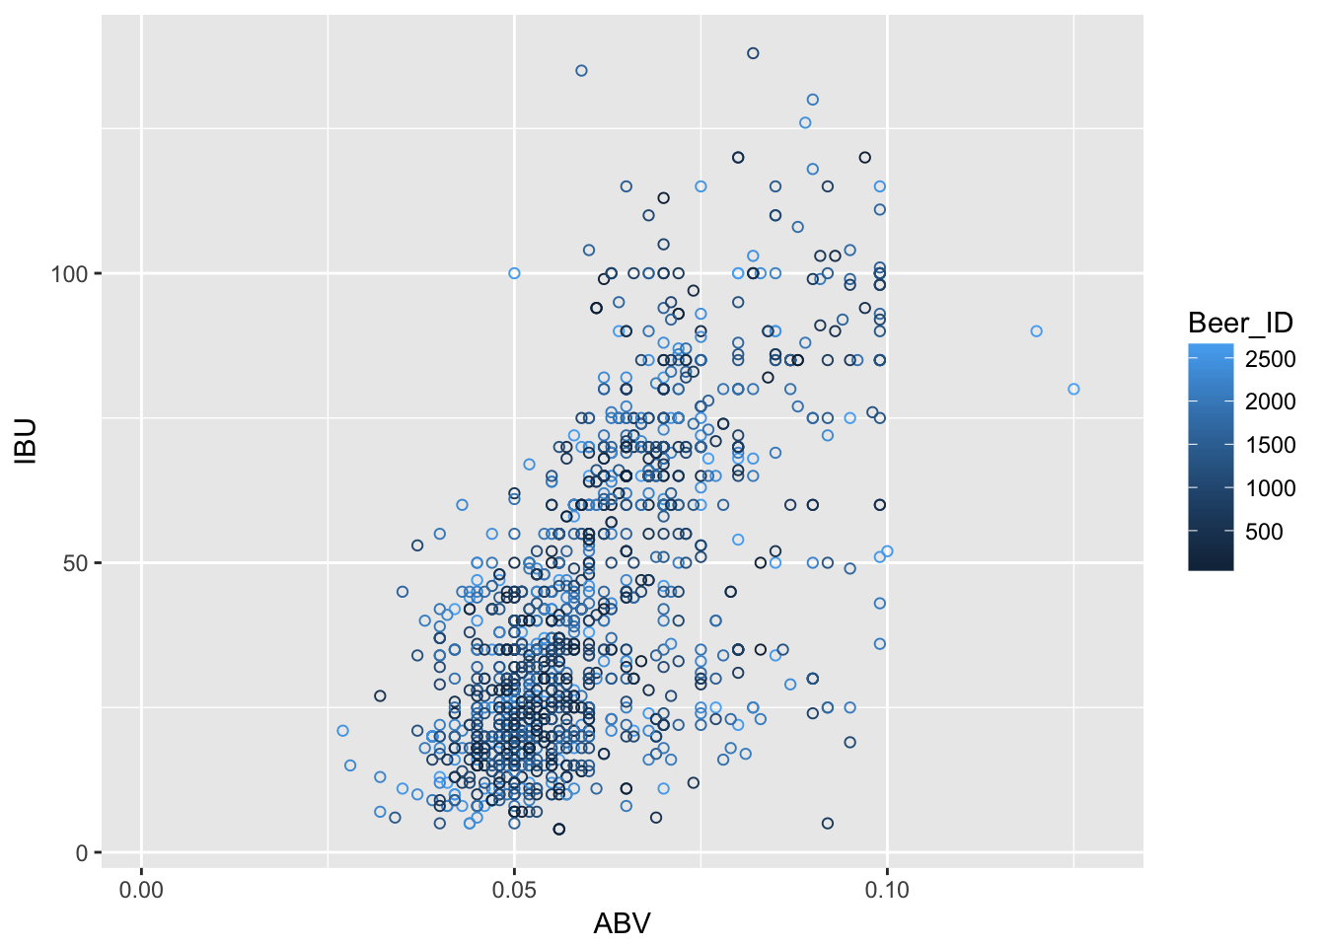
Summary of Results (cont’d): Project Beer
From the scatterplot to the right, it appears that there is a positive correlation between alcohol levels and bitterness.
Assertion is made solely based on visual results of scatterplot.

Slide 7
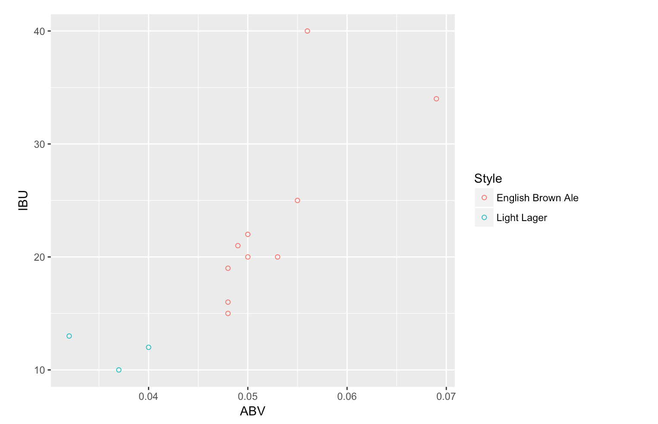
Summary of Results (cont’d): Project Beer
The final Scatter Plot on the right shows a clear separation between the two groups of beer types of dark vs light

Slide 8
Key Take-Aways / Next Steps: Project Beer
Relationship between ABV and IBU: there appears to be a positive correlation between these two variables (i.e., higher alcohol ~ higher bitterness index)
Not based on a full statistical analysis;
No current indication as to ‘why’ this relationship exists.
Next Steps: Results are not based on a statistical analysis:
Run a full regression to consider the relationship;
Consider controlling for variables (e.g., # of breweries by state; type of beer; etc.)
Explore the ‘why’ (i.e., is the relationship sought by brewers for customer tastes, or perhaps a by-product of the brewing method)

Slide 9
Attachments: File Reference and Location
All files are available at the following GitHub Repo:
https://github.com/bdelahoussaye/6306Case_Study1.git
Key Data Sources: “Beers.csv” & “Breweries.csv” (collectively “Data”)
Data was merged into “BeerBreweries.csv”
Tools Utilized: Code ‘R’ (code utilized is available in “Code Book for Case Study One.doc”, and various ‘R File’, ‘RMD File’, and ‘R Project’ files).
Please refer to file “README.md” for introduction

Slide 10
Attachments: Unavailable Data Points by Var
Number of NA's in Brewery ID Column: 0
Number of NA's in Beer Name Column: 1067
Number of NA's in Beer ID Column: 0
Number of NA's in ABV Column: 62
Number of NA's in IBU Column: 1005
Number of NA's in Style Column: 0
Number of NA's in Ounces Column: 0
Number of NA's in Brewer name Column: 0
Number of NA's in City Column: 0
Number of NA's in State Column: 0

Slide 11
Attachments: Number of Breweries by State

